Slide 1

BRIGHT COFFE SHOP
MMAKWENA MOHOATSELENG

Slide 2

The Bright Coffee Shop Sales Analysis was conducted to provide data-driven insights that will help the new CEO increase revenue, identify high-performing products, and improve overall business performance. The analysis used historical transaction data to evaluate sales patterns, product performance, and customer purchasing behavior.

Slide 3
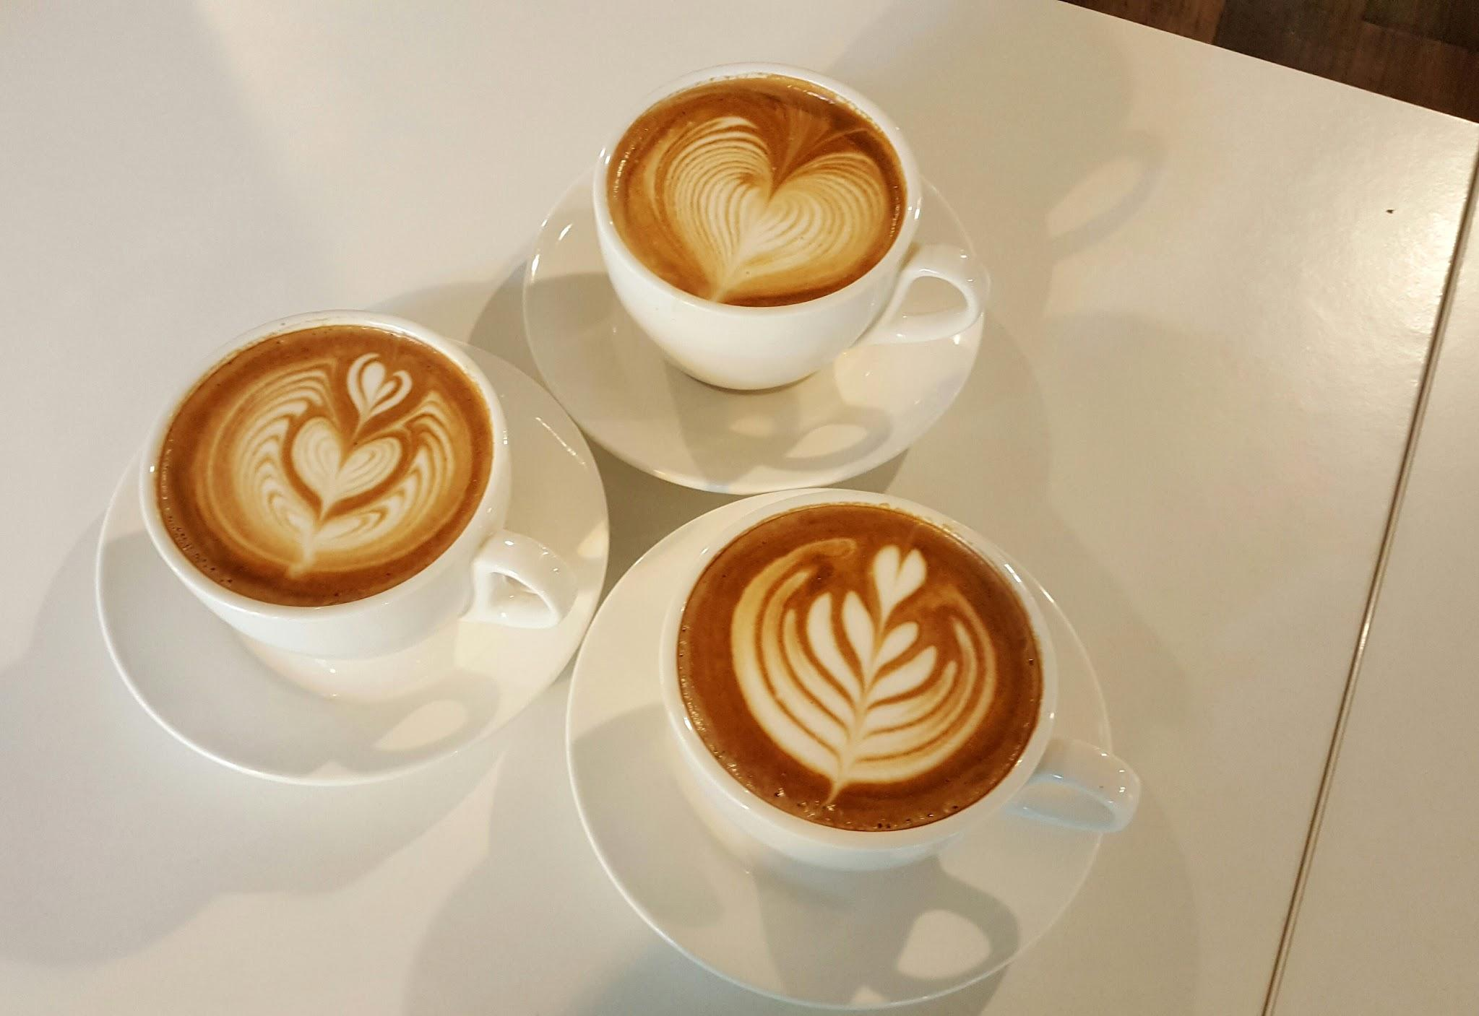
TOTAL SALES
Total revenue R 698 812
Total transactions 149 116

Slide 4

MONTHLY SALES PER LOCATION
STORE_LOCATION | Sum of REVENUE
Astoria | R 232 243,91
Hell's Kitchen | R 236 511,17
Lower Manhattan | R 230 057,25
Grand Total | R 698 812,33

Slide 5
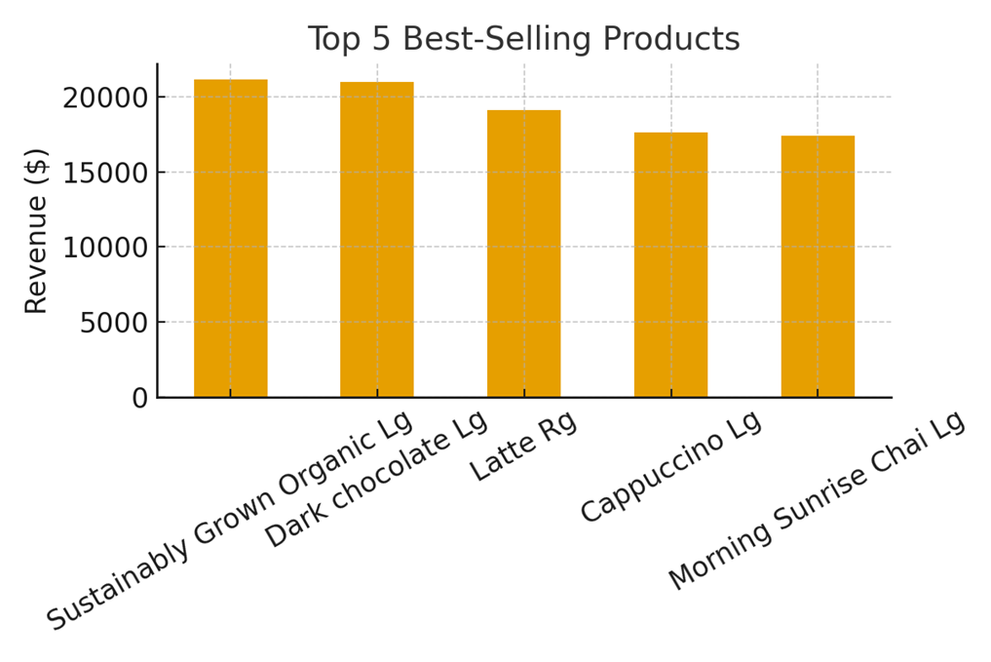
PRODUCT CATEGORY

Slide 6
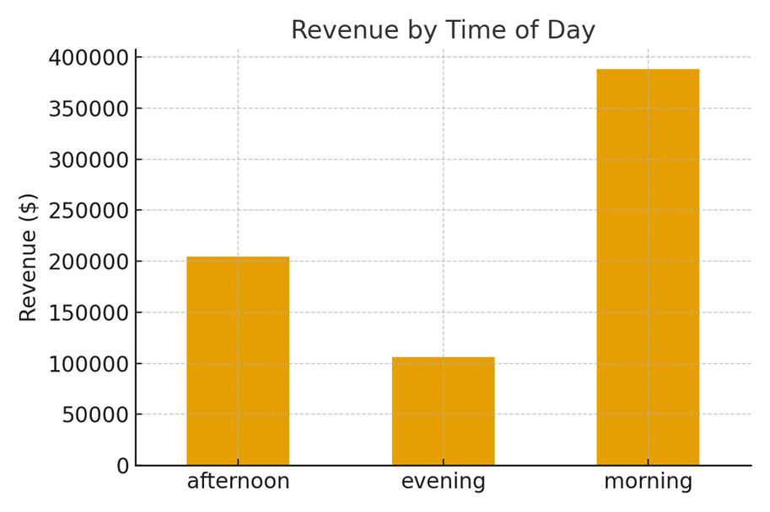
REVENUE BY TIME

Slide 7
DATA OVERVIEW
Top Revenue Products: Coffee beverages and espresso drinks are the main revenue drivers.
Peak Sales Periods: Most transactions occur during morning hours (7 AM – 10 AM) and lunchtime (12 PM – 2 PM).
Trends Over Time: Weekdays consistently outperform weekends in sales volume, indicating strong commuter demand.
Low-Performing Items: Certain pastries and cold beverages show lower sales and may benefit from promotional strategies.
Overall Performance: Sales patterns reveal predictable peaks, suggesting potential for targeted marketing and inventory optimization.

Slide 8
CONCLUSION
The Bright Coffee Shop analysis highlights clear opportunities for growth through optimized inventory, targeted marketing, and data-driven decision-making. By focusing on peak times, high-revenue products, and underperforming categories, the business can maximize sales efficiency and enhance customer satisfaction.

